Slide 1

Final Year Project Presentation
Vehicle Alarm System Based on Drowsiness and Speed
By
Anil Kumar Sonkar (2016021014)
Anshika Kankane (2016021019)
Jitendra Chaudhari (2016021118)
Under the Guidance of
Muzammil Hasan
(Asst. Professor)
Department of Computer Science & Engineering
Madan Mohan Malaviya University of Technology
Gorakhpur, India

Slide 2
Contents
Introduction
Problem Statement
Components Required
Methodology
Quality Requirements
Results & Practical Implementation
Conclusion And Future Scope
References

Slide 3
Introduction
What is Drowsiness and Overspeeding?
Every year 1550 deaths and 71,000 injuries can be ascribed to accidents due to the driver fatigue.
A few systems already had been created, considering recording of head developments, movement of steering wheel etc.
The algorithm of eye detection system integrated with hardware to develop the smart vehicles, which can implement nationwide to avoid the road accidents.

Slide 4
Problem Statement
We are trying to generate an alarm system which is based on drowsiness state of the driver and the current speed of the vehicle by using Machine Learning algorithm and Google API.
Video Stream Estimated Drowsiness
Speed Calculation Speed Comparison
Acquisition System
Video Stream
Processing & Speed Detection
Alarm System

Slide 5
Components Required
Hardware Requirements:
Processor – Intel i3 or above/ Smartphone
Hard disk – 128 GB or more
Memory – 4 GB or above
Web Camera
Software Requirements:
Web Browser
GPU
GPS Receiver

Slide 6
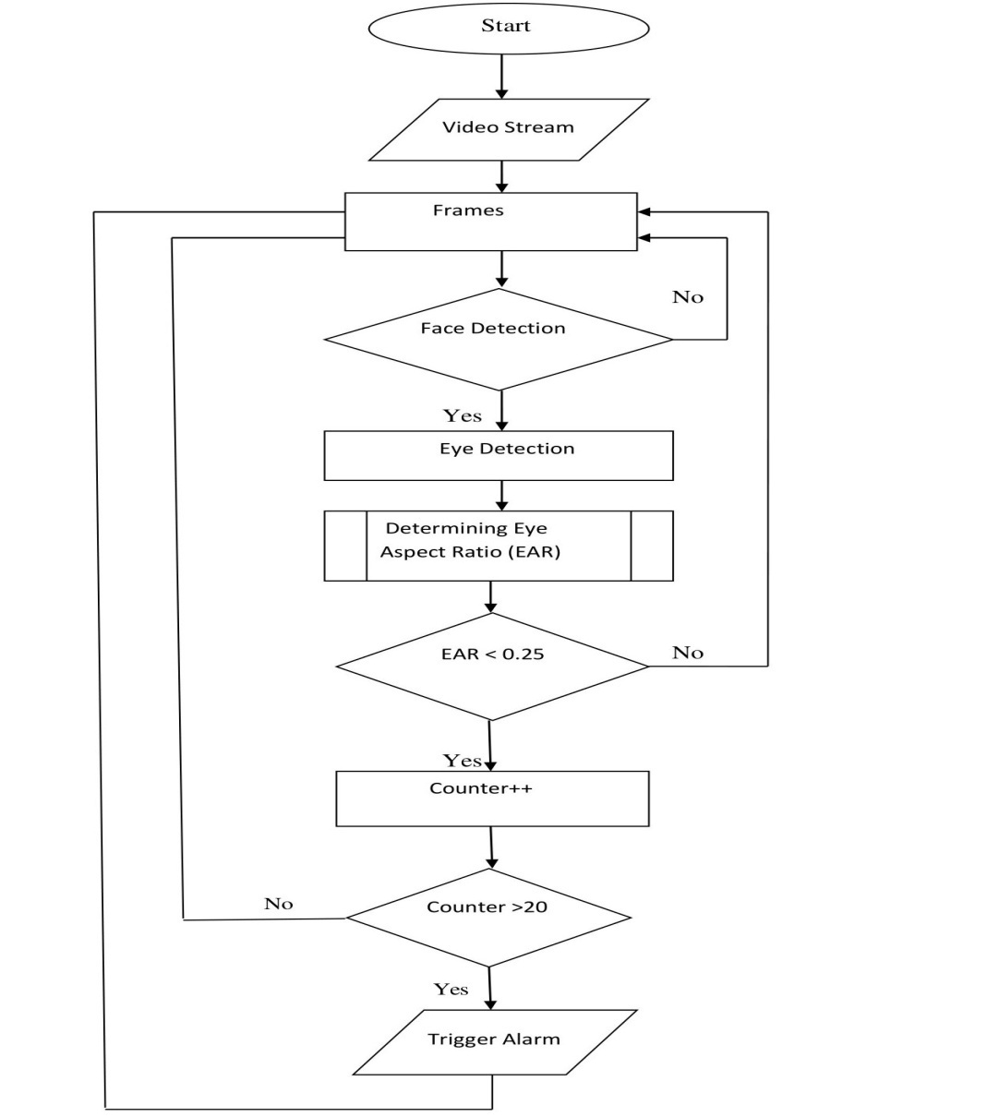
Methodology
Steps for Drowsiness Detection

Slide 7
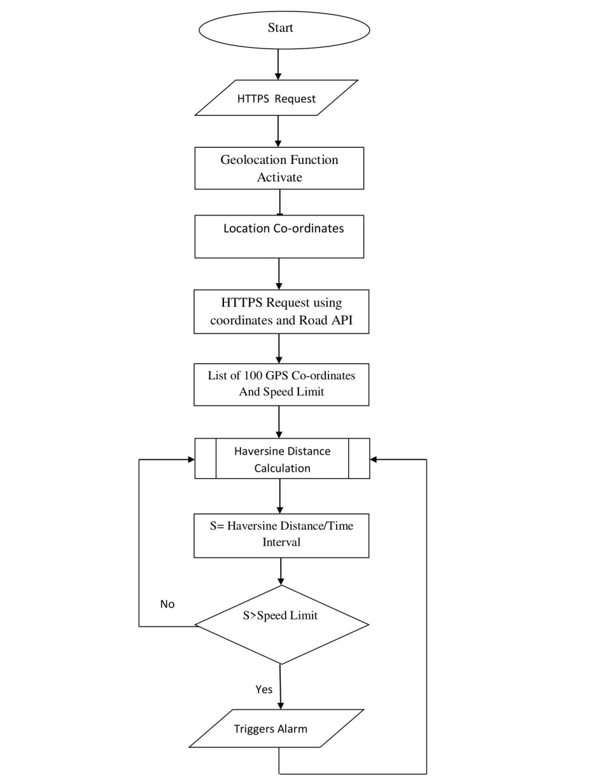
Steps for speed detection and comparison

Slide 8
Used Libraries/Packages:
cv2.PyPi
imutils.PyPi
pyglet.PyPi
dlib.PyPi
pyinstaller.PyPi
haversine. PyPi
Geolocation API
Roads API

Slide 9
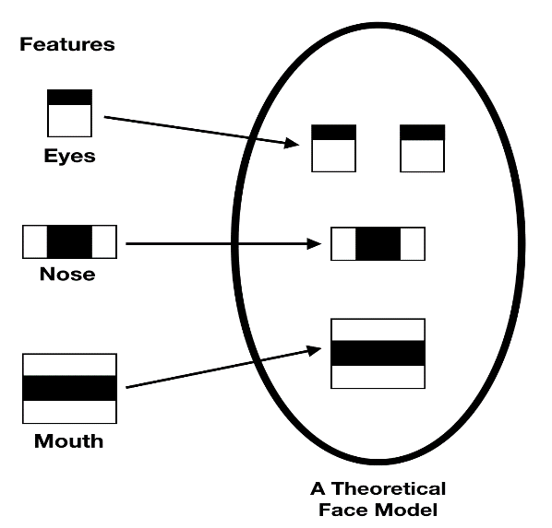
What is a Haar Cascade algorithm? Haar is a machine learning object detection algorithm used to identify objects in an image or video. It has a cascade function that is trained from a lot of positive and negative images. This algorithm has four stages: 1) Haar Feature Selection 2) Creating Integral Images 3) Adaboost Training 4) Cascading Classifiers

Slide 10
Why use Geolocation API?
The HTML Geolocation API is used to get the geographical position of a user. The getCurrentPosition() method is used to return user’s location and the showPosition() function outputs the Latitude and Longitude.
Why Road API?
The Roads API returns the posted speed limit for a given road segment. A request for speed limits must be sent via HTTPS of the form-
https://roads.googleapis.com/v1/speedLimits?parameters&key=YOUR_API_KEY

Slide 11
Request using path:
Response of this request:
https://roads.googleapis.com/v1/snapToRoads?parameters&key=YOUR_API_KEY
{ speedLimits: [ { placeId: "ChIJX12duJAwGQ0Ra0d4Oi4jOGE", speedLimit: 105, units: "KPH" }, { placeId: "ChIJLQcticc0GQ0RoiNZJVa5GxU", speedLimit: 70, units: "KPH" }, { placeId: "ChIJJ4vQRudkJA0RpednU70A-5M", speedLimit: 55, units: "KPH" } ],

Slide 12
snappedPoints: [ { location: { latitude: 38.75807927603043, longitude: -9.037417546438084 }, originalIndex: 0, placeId: "ChIJX12duJAwGQ0Ra0d4Oi4jOGE" }, { location: { latitude: 38.689653701836896, longitude: -9.177051486847693 }, originalIndex: 1, placeId: "ChIJLQcticc0GQ0RoiNZJVa5GxU" }, { location: { latitude: 41.13993011767777, longitude: -8.609400794783655 }, originalIndex: 2, placeId: "ChIJJ4vQRudkJA0RpednU70A-5M" } ], warningMessage: "Input path is too sparse. You should provide a path where consecutive points are closer to each other. Refer to the 'path' parameter in Google Roads API documentation." }

Slide 13
Code to find user’s location using Geolocation function:
<script>
function showPosition(position){
var x = "Your current location is (" + "Latitude: " + position.coords.latitude
+ ", " + "Longitude: " + position.coords.longitude + ")";
var y = "Your current speed is (" + position.coords.speed+ ")";
document.getElementById("location").innerHTML = x; document.getElementById("location").innerHTML = y;
}
</script>

Slide 14
Quality Requirements
Reliability
Efficiency
Security
Maintainability
Easy to use

Slide 15
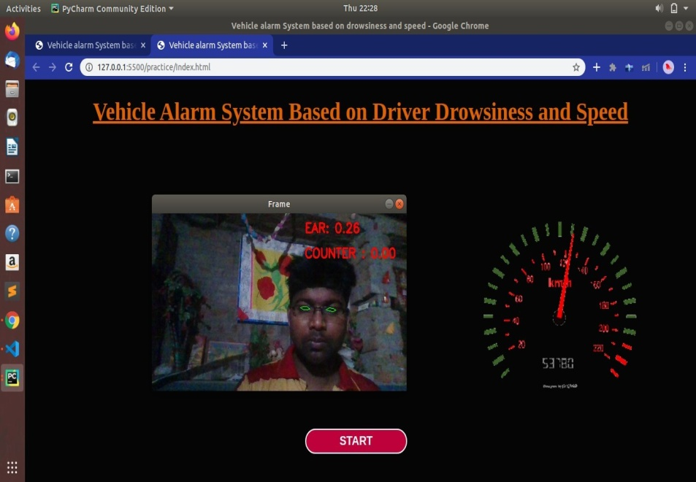
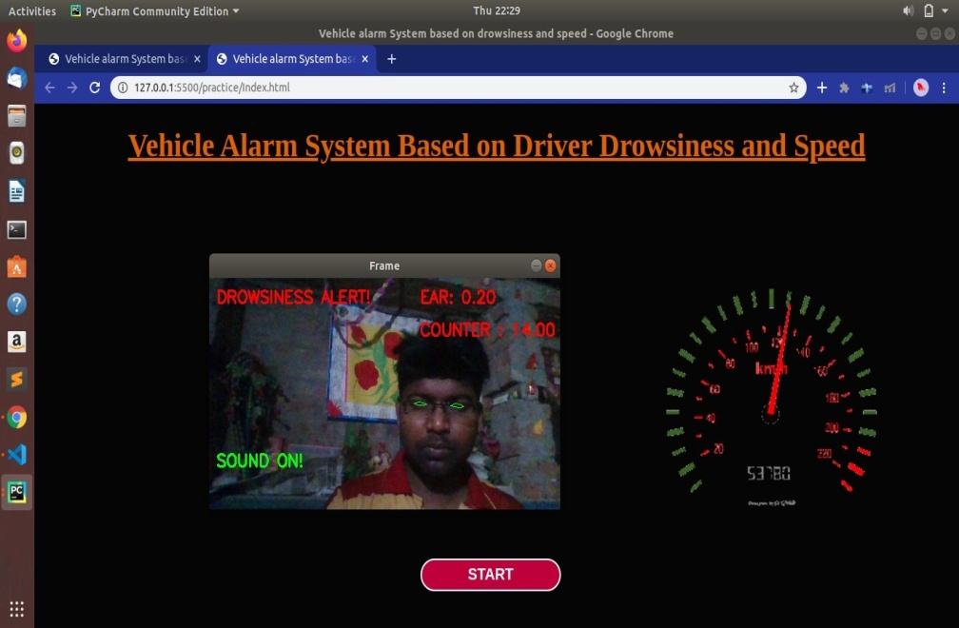
Results & Practical Implementation
Snapshots of website
When the driver is awake (eyes open) When the driver is sleepy

Slide 16
Result
The system works efficiently in all the above cases with an alarming sound. The alarm sounds for both the features is different, that is, the sound for drowsiness alert and the sound for speed system will be different so that the driver can clearly know the difference between both the alerts.

Slide 17
Conclusion And Future Scope
Conclusion
This system generates a warning alarm either if the driver closes his/her eyes or blinks eyes frequently signifying the drowsiness/fatigue stage.
There is an additional feature in our system which warns with alarm if the vehicle is over speeding. It compares the current speed of the vehicle with the permitted speed limit on the location in real time.

Slide 18
Future Scope
The present work on drowsiness and speed based alarm system for vehicles is a promising solution for safety in vehicles and trains.
It can prevent further damage to vehicle and its riders in case of an accident To generate a warning alarm if any of the above case is fulfilled.
This can result in the decrement of the number of accidents.
This will be easy to use and cheaper to install.

Slide 19
References
http://ieeexplore.ieee.org.sci-hub.tw/xpl/artic%C2%ADleDetails.jsp?arnumber=7493990\ by Javed Ahmed, Jian Ping Li, Saeed Ahmed Khan, Riaz Ahmed Shaikh.
http://www.willberger.org/cascade-haar-explained/
https://developers.google.com/maps/documentation/roads/speed-limits
https://www.w3schools.com/html/html5_geolocation.asp

Slide 20
THANK YOU!

